Slide 1
Exam question topics overview
1.Derive a transfer function for a dynamical system e.g. mechanical system Be able to write down differential equations of mechanical and electrical systems and applying Laplace transforms 2.Analyze a canonical 2nd order system analysis Compare with canonical equations and specify canonical parameters (damping, natural frequency, overshoot etc.) 3.Derive the state space model for a linear dynamical system Indicate if the system is stable, controllable and observable 4.Analyze a non-linear dynamical system Use linearization based on the Jacobian method to derive a linear state space model in matrix form 5.Design a state feedback controller Specify state feedback gain using pole/eigenvalue placement by algebraic manipulation by hand. 6.Observer and integral control Understand these concepts and how to implement them 7.Design an optimal feedback controller Specify state feedback gain using Algebraic ricotta equations

Slide 2
ROCO218: Control Engineering Dr Ian Howard Tutorial 3 ROCO218 2017 Exam example

Slide 3
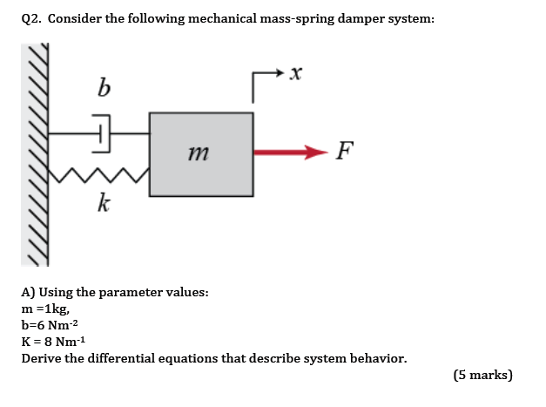
Q2: Mechanical system

Slide 4
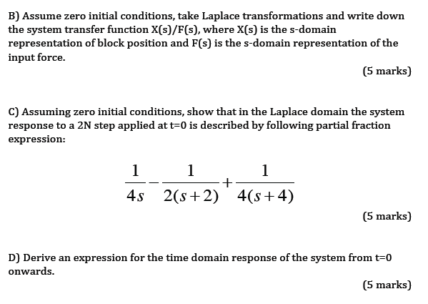
Q2: Mechanical system

Slide 5
Q2: Mechanical system
There differential equation that describes the system is
Taking the Laplace transform with zero initial conditions
inserting m = 1, b = 6, k=8.
Therefore transfer function from F(s) to X(s)

Slide 6
Q2: Mechanical system
A step input f 2N corresponds to
The system response to a step input is therefore
Factorising this denominator
Representing in partial fractions

Slide 7
Q2: Mechanical system
Setting RHS to common denominator
So matching numerator coefficients on both sizes
Multiplying out

Slide 8
Q2: Mechanical system
So given
Matching powers of s²
Matching powers of s
Matching constant values
Solving the remaining equations by eliminating C

Slide 9
Q2: Mechanical system
So since
Reminder: From Laplace pairs table we see that
Substituting in the values
Taking inverse Laplace transforms we see the time response to step input is given by

Slide 10
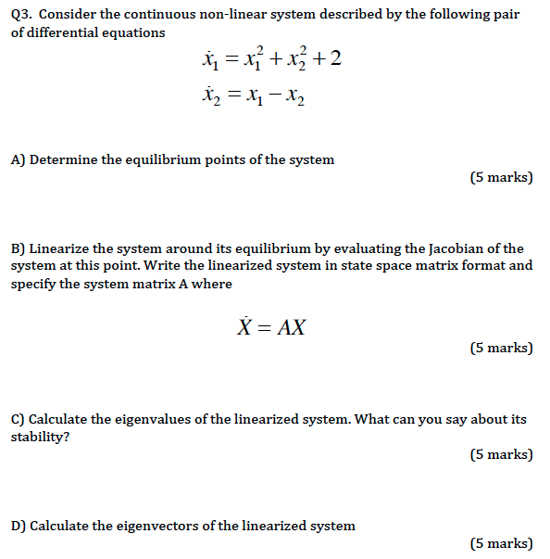
Q3b: Continuous-time nonlinear control system

Slide 11
Q3b: Continuous-time nonlinear control system
Equilibria occur when the system is stationary
To find the equilibria we must therefore solve the equations
Substituting in
Here we consider the +ve equilibrium position of system (1) = (j,j)
To linearize the system we need to evaluate the Jacobian at this point
From the state equations we can write

Slide 12
Q3b: Continuous-time nonlinear control system
Given these two functions
The Jacobian of the system is a 2x2 matrix since we have 2 state variables
Taking partial derivatives w.r.t. to state variables
Evaluating at (j,j)

Slide 13
Q3b: Continuous-time nonlinear control system
Linearized system in state space matrix format is therefore
System stability is is found by examining the eigenvalues λ of the Jacobian matrix which is achieved by solving the equation
Where X are the corresponding eigenvectors
If the term
has an inverse then
This is the trivial solution!
However we get a non-trivial solution when the Jacobian term has no inverse, which occurs when

Slide 14
Q3b: Continuous-time nonlinear control system
Expanding out the expression
For a 2x2 matrix the determinant is given by
Characteristic equation is therefore
Solution is therefore
Therefore–ve real eigenvalue so system stable

Slide 15
Q3b: Continuous-time nonlinear control system
The eigenvectors X and eigenvalues λ satisfy the equation
Multiplying out terms gives
Where

Slide 16
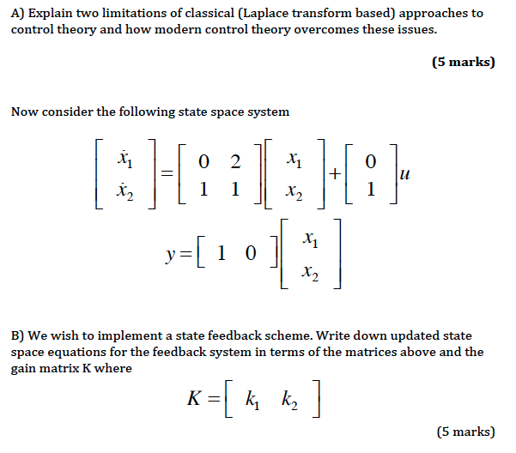
Q4: State feedback control

Slide 17
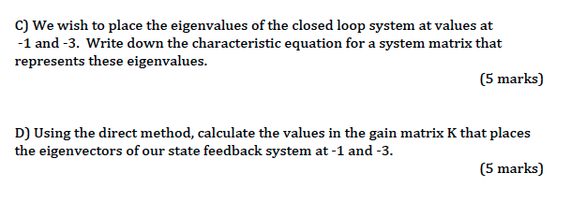
Q4: State feedback control

Slide 18
Q4: State feedback control
State space equations take the form
The given system state space equations are
Therefore the system matrices are

Slide 19
Q4: State feedback control
We now apply feedback to the state space equation
This is achieved by setting the input U to
Where the gain vector is given by
This leads to the the modified system dynamics equation
So the stability of the feedback system is determined by location of its poles which are the eigenvalue of the matrix (A-BK)
The eigenvalues λ of the closed loop system are thus given by

Slide 20
Q4: State feedback control
Using the system matrices
Substituting in values
The characteristic equation is therefore

Slide 21
Q4: State feedback control
Simplifying the characteristic equation
We require that the eigenvalues λ of the controller system are at -1,-3
Therefore we want the following characteristic equation
We now need to match the coefficients in the desired eigenvalues characteristic equation using the appropriate gains k₁ and k₂ therefore:
Feedback law is therefore

Slide 22
ROCO218: Control Engineering Dr Ian Howard Tutorial 3 ROCO316 2015 Exam solutions

Slide 23
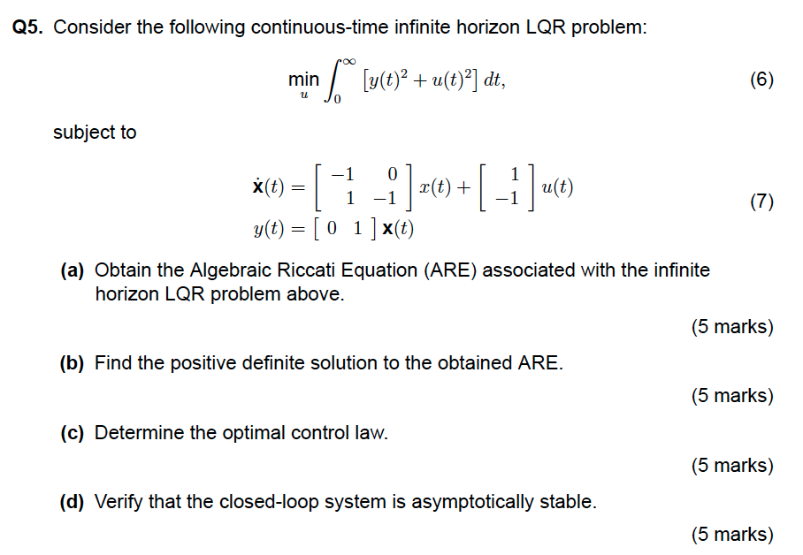
Q5: Optimal control

Slide 24
Q5: Optimal control
From state space system
Computing a value of Q to penalize state error
Setting a value of R to penalize control

Slide 25
Q5: Optimal control
The algebraic Riccati equation is given by
Matrix P is unknown and symmetric so we write
Thus the algebraic Riccati equation becomes

Slide 26
Q5: Optimal control
So from
Evaluating terms

Slide 27
Q5: Optimal control

Slide 28
Q5: Optimal control

Slide 29
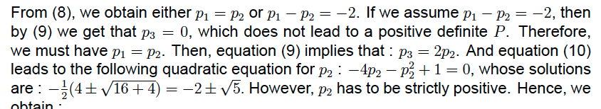
Q5: Optimal control
Equating terms leads to 3 simultaneous equations
Want positive definite matrix P
Eqn 1
Eqn 2
Eqn 3

Slide 30
Q5: Optimal control
Control law given by
The matrix of the resulting closed-loop system is given by

Slide 31
Q5: Optimal control
Eigenvalues λ of A_{cl} given by
Real part of eigenvalues always negative therefore system stable

